Slide 1
Hearing and listening, survival and satisfaction in sentient animals
John Webster
Professor Emeritus,
University of Bristol

Slide 2
Sound: definitions
”If a tree falls in the forest does it make a sound if there is nobody there to hear?”
Physical
  Oscillation in pressure, particle displacement, particle velocity, etc., propagated in a medium (i.e. air, water, solids) i.e. YES
Physiological
  Auditory sensation evoked by the oscillation described above: i.e. NO

Slide 3
Lower limits to audio frequency range

Slide 4
Upper limits to audio frequency range

Slide 5
Darwinian fitness: survival and successful reproduction
Achieved through behaviour appropriate to the phenotype.
Musk ox
House mouse

Slide 6
Animal communication by sound
to identify a specific individual or location
to locate the specific individual or individuals to whom a message is to be conveyed
to convey a specific message
to avoid, where possible, alerting predators.
(language seldom, if ever, necessary)

Slide 7
Crow using tools

Slide 8
”What is important? ” – priorities for fitness
Outcomes
- survival,
- reproductive success,
Motivation
- survival (hunger, thirst, security)
- avoidance of pain and distress
- satisfaction (physical and mental wellbeing)
- (pleasure)

Slide 9
Strategies for success
Survival and security – eat and be not eaten
  Predators – prey location
  Prey – alarm calls, “secret messaging”
Reproduction
  Mating
  Bonding
  Child rearing
Social communication
  Security
  Companionship

Slide 10
Prey location: owls
Owls with asymmetrically placed ears can calculate elevation and horizontal angle of a sound source (e.g. mouse)

Slide 11
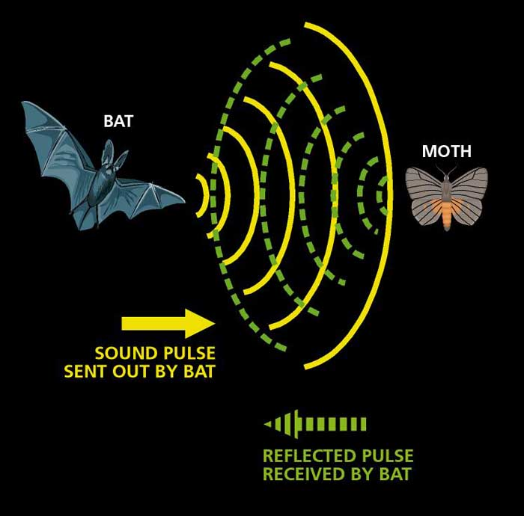
Prey location: bats

Slide 12
Echolocation: whales and dolphins
Clicks in the (human) audio-frequency to locate prey, depth of water, holes in the ice etc.
(distinct from “singing”)

Slide 13
Prey behaviour
Alarm calls
  More warning than fear – promote safety of family/social group
  Chimpanzees, vervet monkeys (and domestic hens) have threat-specific sounds
      snake – look down, eagle –look up
“Secret messaging”
  Mice communicate alarm calls in ultrasound (audible to cats?)

Slide 14
Strategies for success: 2.
Survival and security – eat and be not eaten
  Predators – prey location
  Prey – alarm calls, “secret messaging”
Reproduction
  Mating
  Bonding
  Child rearing
Social communication
  Security
  Companionship
  “Pleasure?”

Slide 15
Bird song
Mating
  Sexual selection: attracting females and competition with other males
    in temperate zones with predictable breeding seasons, males sing (mostly). In tropical and desert zones both sexes sing.
Bonding
  ”Duetting” strengthens bonds and increases reproductive success: (quail, some owls)
Child rearing
  Father birds teach their offspring to sing (which is how they can acquire regional accents)

Slide 16
Other mating calls.
Singing whales
Rutting and lecking in stags
“Bulling” calls by cows in oestrus.

Slide 17
Parent/offspring communication
“keep safe and don’t get lost”
  Distinctive alarm calls in birds: Parents introduce chicks to alarm calls while still in the egg
  Dolphins have “signature whistles”
Ewes can recognise their lambs by sound (and sight) among >200 others

Slide 18
Social communication (outside the immediate family)
Security
  Alarm calls (primates)
Companionship
  Wolf calls (extended families)
Pleasure
  Cello and the nightingale?
  Why do cats purr?

Slide 19
Summary and conclusions
Sentient animals selectively listen to the sounds that they identify as important because they convey information relevant to their needs to achieve security, satisfaction and reproductive success.
Clear evidence that sentient animals express signs of pleasure
  But can they enjoy music?

